Slide 1
Check Environment
Karla Griffin

Slide 2
Objectives
Learn the difference between visual and radio line-of-sight
Learn multiple techniques to improve radio communication

Slide 3
Goal
Clear up telemetry issues as soon as possible

Slide 4
Visual line-of-sight
A direct visual line between antennas with no obstructions

Slide 5
Radio line-of-sight
The Fresnel Zone (fruh-nel) surrounding the visual line-of-sight path

Slide 6
Causes of interference

Slide 7
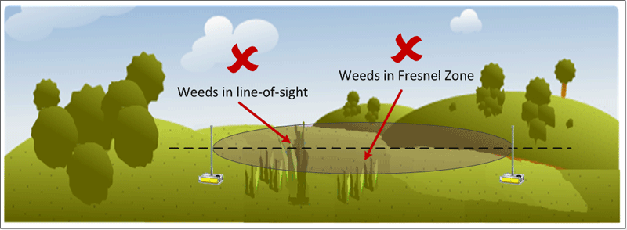
Weeds
Weeds can interfere with communications

Slide 8
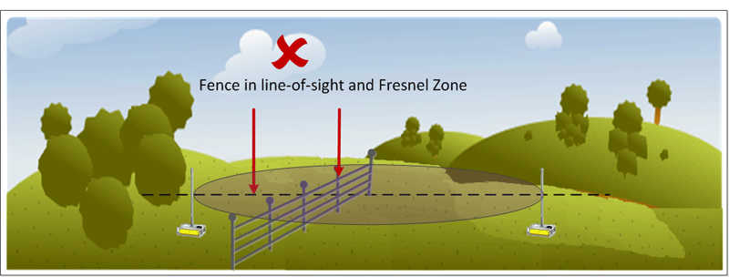
Fences
Fences can interfere with communications

Slide 9
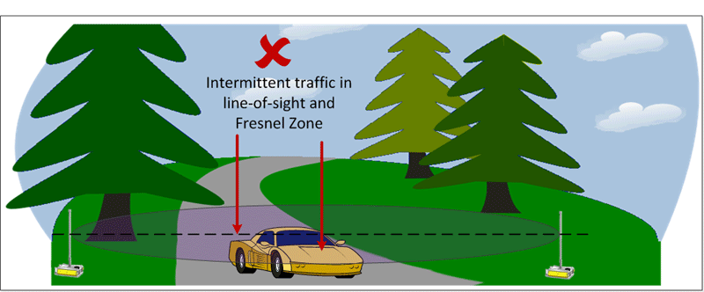
Traffic
Traffic can interfere with communications

Slide 10
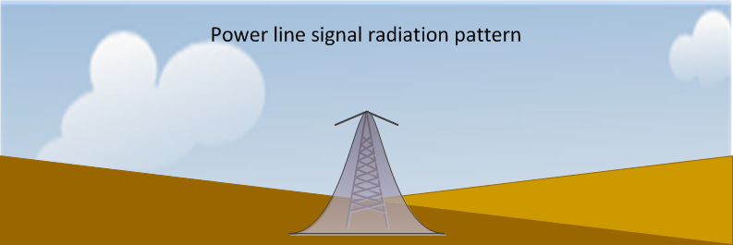
Power line interference
EMF signals are strongest directly below an overhead power line or above an underground power line.
EMF signals decrease rapidly as you move away from the source.

Slide 11
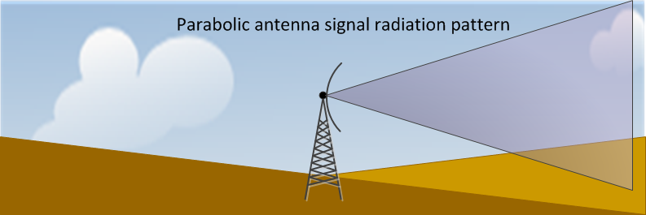
Microwave interference
Microwave signals are transmitted with a parabolic antenna; there may be an area near the base or on the opposite side of the antenna that is free from radiated signals, but signal interference may occur further out from the tower.

Slide 12
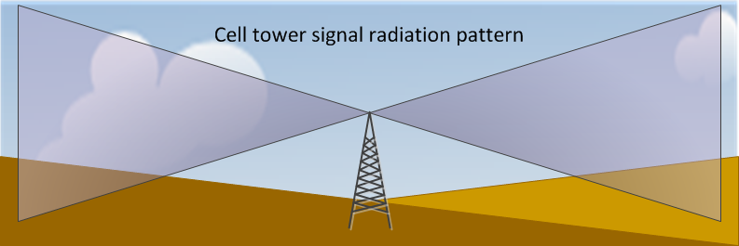
Cell tower interference
The radiation pattern of a cell tower is similar to that of a dipole antenna; there may be an area near the base that is free from radiated signals, but signal interference may occur further out from the tower.

Slide 13
Troubleshooting

Slide 14
Are both the visual and radio line-of-sight clear?
Yes
No

Slide 15
Is the unit in the power line radiation pattern area?
Yes
No

Slide 16
Is the unit in the microwave radiation pattern area?
Yes
No

Slide 17
Is the unit in the cell signal radiation pattern area?
Yes
No

Slide 18
Move the unit
If the unit is in the radiation pattern area of a tower, move it to a different location.
Click to continue

Slide 19
Replace the unit
If the unit is not getting interference from a tower radiation pattern, or interference in the line-of-site area, replace the unit.
Click to continue

Slide 20
Are there still communication issues?
Yes
No

Slide 21
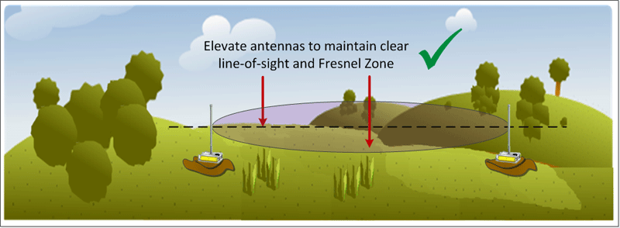
Weeds can interfere with communications
Check and clear vegetation
Elevate antennas with risers or pile dirt or rocks under unit

Slide 22
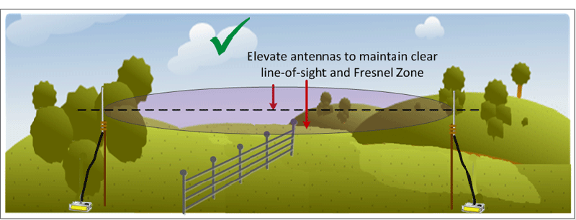
Fences can interfere with communications
Elevate antennas above fences

Slide 23
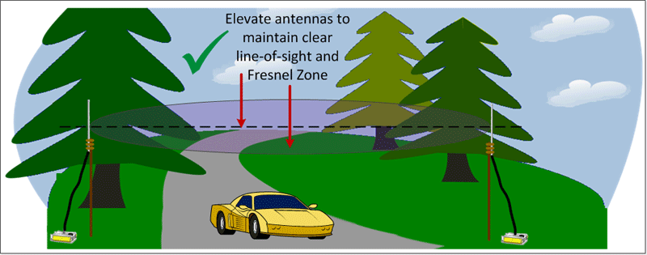
Traffic can interfere with communications
Elevate antennas above traffic

Slide 24
Are there still communication issues?
Yes
No

Slide 25
The End!
Check Environment
Karla Griffin

